Slide 1



Project Plan
Galleria Holdings UK

Slide 2

Main Objective: A Fast-food chain Galleria Holdings, would need to develop a data warehouse for business intelligence purposes which means they need a reporting system of ‘items sold’ or ‘recipes sold’ to get an accurate drilldown of most popular items vs least popular. Not currently aware of how they menu are being received in the market and believe that are too large and inconsistent.
This will allow them to streamline their menu across the brand to suit the needs and requirements of the customers.

Slide 3

Setting the Scene
Criticism of fast food is well known and claims of negative health effects, high calories, trans fats and high in fat, sugar, and salt.
According to the UK Government, obesity is one of the biggest health crises the country faces as almost two-thirds (63%) of adults in England are overweight or living with obesity and 1 in 3 children leave primary school overweight or obese. Obesity-related illnesses cost the NHS £6 billion a year.
A good control of products and services can help to create a menu that offers the customer healthy food and good income for the company. It is necessary to have a balance on the control of costs and revenues, the excess or lack of stock can end up harming the growth of any company. And this is only possible with the analysis of information and good monitoring.
https://www.gov.uk/government/news/promotions-of-unhealthy-foods-restricted-from-october-2022

Slide 4

Regarding the difficulties imposed after covid-19, some sectors had to adapt, take innovative actions, and optimize solutions to face this new challenge that impacted the entire world and succeed.
With that in mind, I prepared an implementation project in which some additional relevant business questions for reporting purposes were raised:
Average customers spend – this will help a company identify which individual stores are not upselling. This can be used so the stores with a lower average spend can improve their sales.
Delivery Sales % vs Net Sales – This will allow a store to see if they are serving a lot of customer or more deliveries. The higher % of deliveries could indicate poor customer service as there is less customers going into a store.
Location and date of orders, along with the description of products, categories and subcategory and segments of clients (or payment).
Location and date of orders, along with the description of products, categories and subcategory and segments of clients (or payment).

Slide 5
Understanding the Problem Domain
This project also aims to create a dashboard that presents the identification of a group of items that should be removed or replaced, analysis of customer segments, conducting studies of the aspects necessary for its development. This analysis will be used by the company Dreams LTD, specialized into sales of fast-food; and will analyse sales made in the period 2016 to 2019 in the database provides by the QA team, it will also assist in decision making, control of unnecessary purchases of food which is not chosen by customers, and categories of top selling products and projection for the next years. The analysis of items and how the dashboard will be developed, its structure, design, and the definitive version of the project.

Slide 6





Main Services
On-premises, cloud-based, or hybrid data engineering?
Evaluating Solutions
Talysson Oliveira

Slide 7
Cloud computing
It’s no longer a myth for organizations, on the contrary. Large enterprises have moved their systems to the cloud in search of its benefits. The cloud computing business model ranges from hosting and using public internet infrastructures to creating one's own cloud infrastructure within the organisation's premises in a so-called private cloud model.

Slide 8
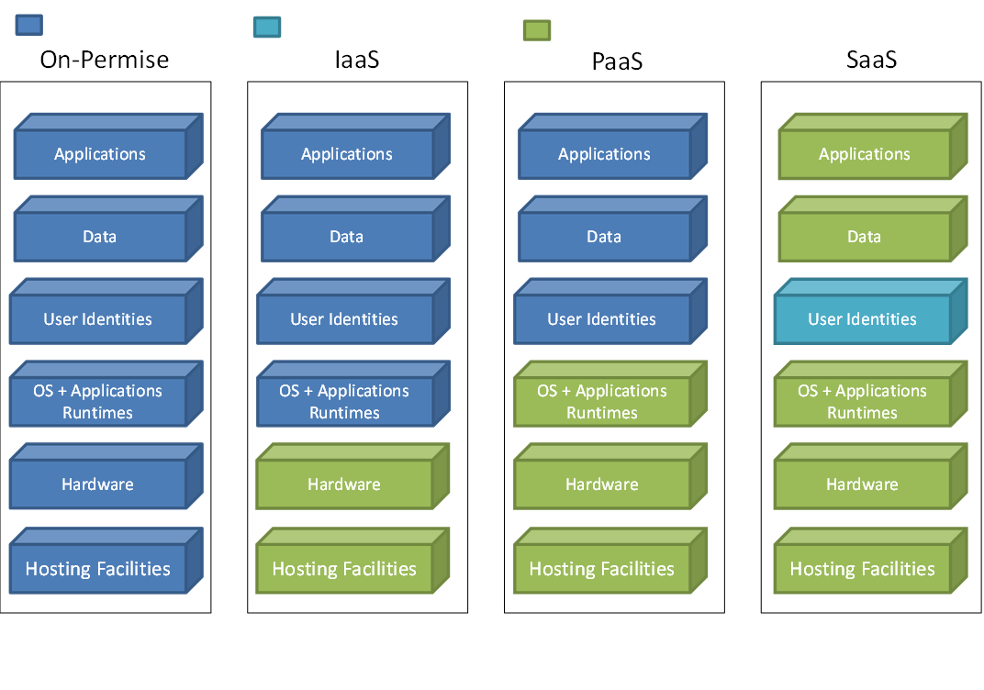
The on-premise system is a data storage system, also called server, which integrates all the information of the activities of a company. The structure is totally implemented in the company's physical space.
The IaaS service model is one of the pillars of cloud computing. It consists of the availability of servers and data centers within the context of the cloud, ensuring the much-desired scalability to reduce costs.
PaaS simplifies application development while eliminating the cost and complexity of procurement, hardware and software management, and storage capacity provisioning.
With SaaS, all the functionality of the application is delivered in one package over the network. The user needs do no more than use the application; the SaaS provider takes care of what is associated with the creation and operation of the software, segregating user data, with user security and the SaaS environment, and with various other details.
Owner Manages
Supplier Management
Hybrid Management

Slide 9
From an infrastructure standpoint, Fidelity Investments is combining a private cloud hosted in the company's data centres with multiple public cloud platforms, raising the question of how to manage this hybrid infrastructure?
Fidelity doesn't standardise on any one technology but uses a variety of tools to achieve this.
In systems engineering, quality attributes are realized non-functional requirements used to evaluate the performance of a system. They are sometimes called architecture characteristics, or "diseases" after the suffix that many of the words share. They are usually Significant Architectural Requirements that require the attention of architects.
Some of the capabilities are already supported in one form or another by many of the leading vendors, though manual intervention is still required to take full advantage of them. We expect that in the future, most, if not all, will converge on elastic serverless, cloud-based, fully automated systems that remain optimised for provisioning, performance, security, reliability, and cost minimisation with minimal or no human intervention.

Slide 10

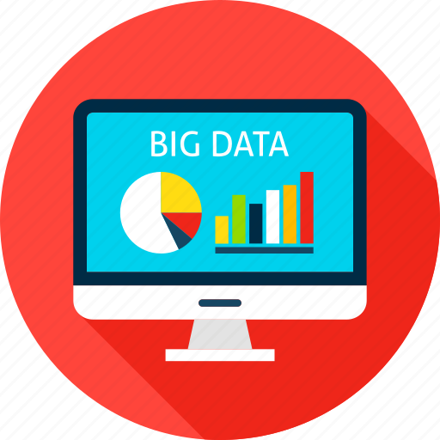
Mastering and managing
Data Understanding

Slide 11

A Review of the Original Model:
Source provided:
SaleDate | TicketNo | Outlet | Total | OrderQty | Stock_Code | Name | Description | Price | Product_Group | Group_name | CardType
01/07/2016 | 82196 | Birmingham | £ 20.00 | 4 | PZ0001 | SCHIACCIATINA | Rosemary, Olive Oil and Sea salt | £ 5.00 | P | Pizza | Visa
01/07/2016 | 82213 | Cardiff | £ 15.00 | 5 | DAB001 | Black Coffee | NULL | £ 3.00 | G | Drinks & Beverages | Money
01/07/2016 | 82193 | Edinburgh | £ 13.50 | 1 | CP0113 | Coq au vin | Chicken stewed with red wine, onions, tomatoes, mushrooms & carrots | £ 13.50 | C | Crepes and Galettes | Debit Card
06/07/2016 | 82258 | Ipswich | £ 8.00 | 1 | CP0119 | La Pomme | Apples sauteed in butter & cinnamon | £ 8.00 | D | Desserts | Maestercard
01/08/2016 | 82434 | London | £ 25.00 | 2 | APP001 | Assiette de pate | 3 pates with cornichons & moutarde | £ 12.50 | A | Starters/Appetisers | Visa
01/07/2016 | 82212 | Middlesborough | £ 8.50 | 1 | BK0161 | Scrambled eggs | Scrambled eggs, spinach & cheddar | £ 8.50 | B | Breakfast | Debit Card
20/04/2017 | 84770 | Peterborough | £ 4.00 | 1 | SD0001 | French fries | Crisp outside, fluffy inside = the best! | £ 4.00 | K | Side Dishes | Debit Card
08/07/2019 | 114041 | Poole | £ 7.50 | 1 | CP0170 | Crepe Japonnais | Teriyaky Salmon & Shitake Mushrooms, with salad | £ 7.50 | C | Crepes and Galettes | Debit Card
19/07/2019 | 114394 | Weymouth | £ 7.50 | 1 | CP0170 | Crepe Japonnais | Teriyaky Salmon & Shitake Mushrooms, with salad | £ 7.50 | C | Crepes and Galettes | Maestercard
31/07/2019 | 114781 | Worthing | £ 7.50 | 1 | CP0170 | Crepe Japonnais | Teriyaky Salmon & Shitake Mushrooms, with salad | £ 7.50 | C | Crepes and Galettes | Debit Card
Dictionary:
SaleDate – Sales from 01/07/2016 to 31/07/2019.
TicketNo – 16.708 different orders.
Outlet – 10 branches in different city of the country.
Total – Total amount of item.
OrderQTY – Quantity of item per order.
Stock_Code – Identity whit initial of group name and numbers.
Name – Item menu name. 77 items on total;
Description – Items description of item menu;
Price – Price unit per item menu. £8 in average;
Product_Group – Identity whit initial of group name;
Group_name – Group of item menu. 9 groups different;
Card_Type – Payment mode. 4 Types different.

Slide 12
A review of the original Model
Analysing the database provided, with 40706 rows we were able to draw several conclusions.
Regarding the frequency of orders value, we can see the majority orders is between £3 to £15 witch means 82% of the database.
The total amount of sales across all regions was £742,366, which is £185,591 average per year.

Slide 13

Data Analysis
In the chart below, we can see the number of orders per department.

Slide 14

Bestselling Items
Pizza, Crepes and Breakfast rank highest in the sales of the company, totaling more than 75% of total sales. Also, in quantity of orders, they exceeds 70% in relation to the total of orders requested.

Slide 15

Least popular items
In the chart below we identify the ten least sold items referring to quantity. From here we can identify, whether or not to streamline the menu or perform additional marketing.

Slide 16

Least popular items
In the chart below we identify the ten least sold items referring to value.

Slide 17

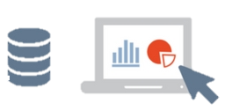
OLAP Database Design
Online Analytical Processing
• Application: strategic level, assists in business analysis and decision making;
• Functionality: generates analysis and management reports with optimized reading data structure: few details, as it has a high level of summarization;
• Data storage: it uses the Data Warehouse to optimise the performance of the large number of data.

Slide 18
OLTP Database Design
Online Transaction Processing
• Application: working level of the company;
• Functionality: high speed, but not ideal for management analysis;
• Data structure: high level of detail;
• Data storage: done by conventional means (without using specific software);

Slide 19
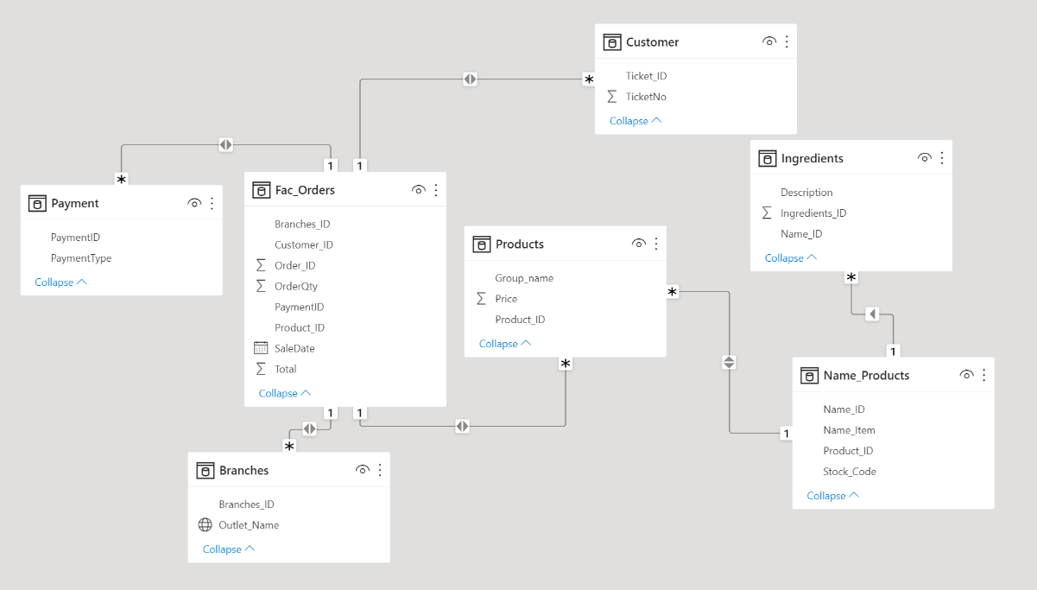
Converting the database to a schema, as part of “best practices of implementing a Data Warehouse” I decided to transform the existing table into multiple tables so that it could speed up the analysis and become consistent and interactive. This conversion is intended to analyse a large volume of data in a dynamic and multidimensional way.
Snowflake Schema:
The snowflake schema is a variant of the star schema. I opted for the Snowflake Schema multidimensional model, which is in the fact table, dimension tables as well as sub dimension tables are contained and presented in a normalized form in multiple related tables.
Star schema:
The star schema is a mature modelling approach widely adopted by relational data warehouses. It requires modelers to classify their model tables as either dimension or fact.

Slide 20
The table below shows putting together the source to target mapping for the data. Implementing the ETL (Extract, Transform and Load) to create and populate the tables in SQL.

Slide 21
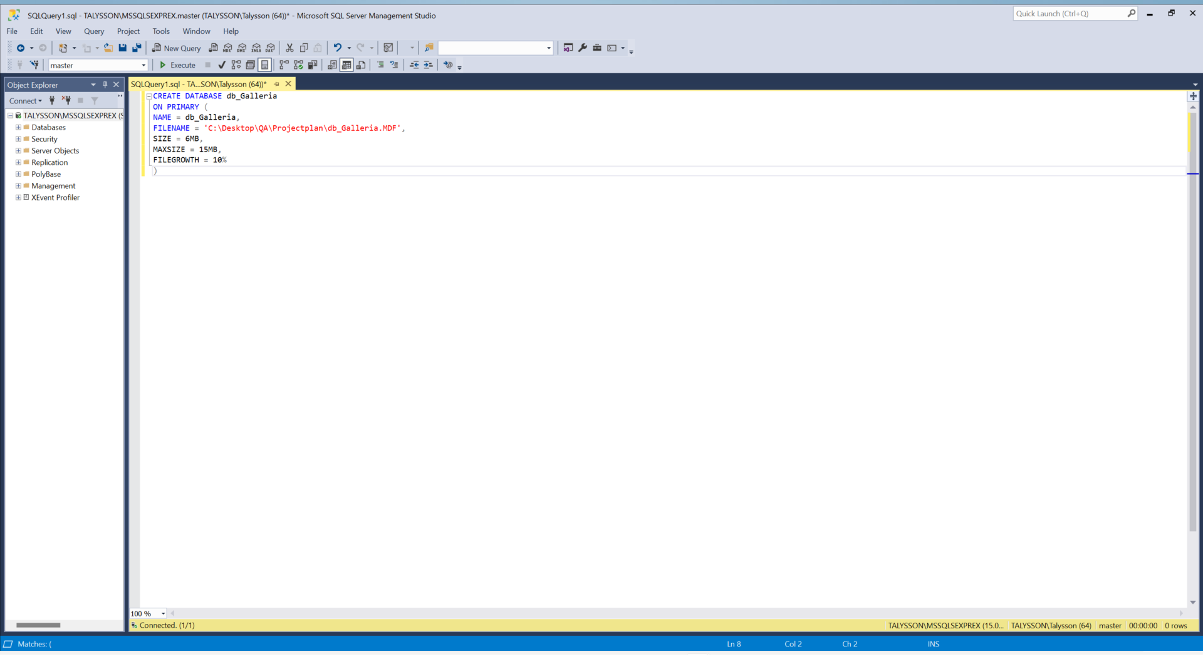
Creating Galleria database on SQL.

Slide 22
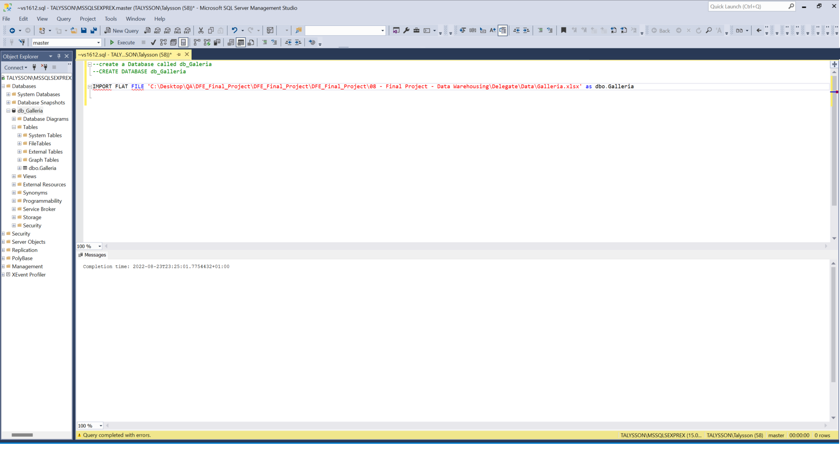
Importing Galleria.txt into database on SQL.

Slide 23
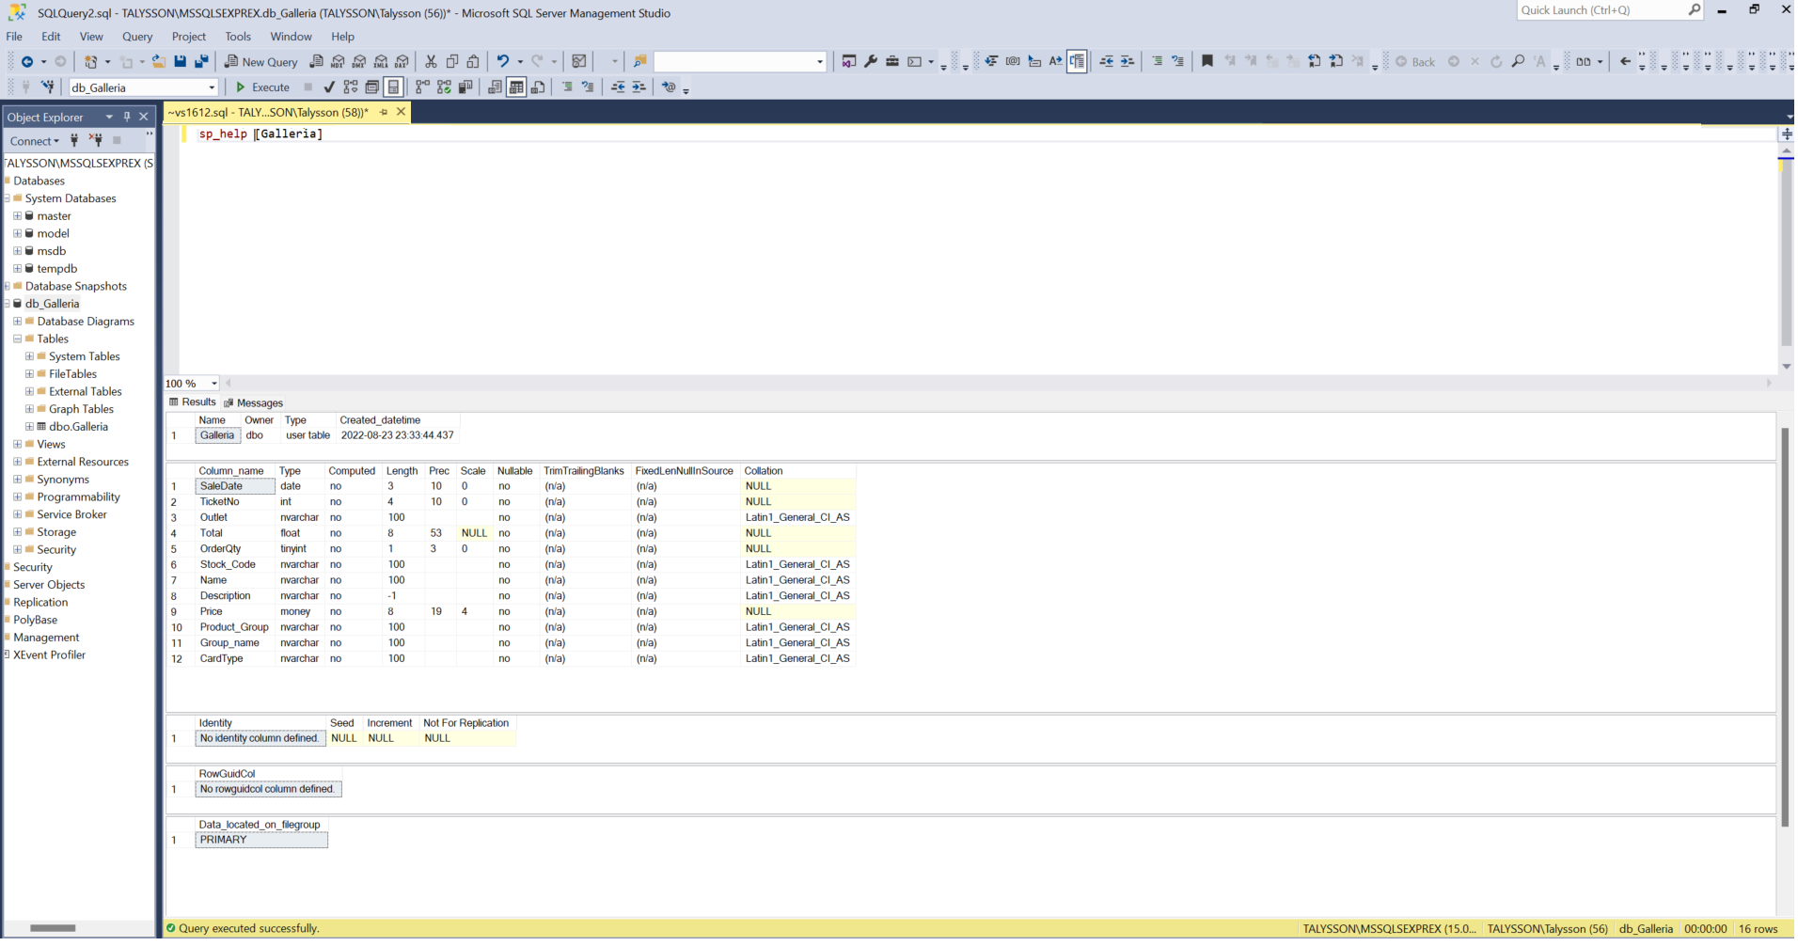
SP_HELP and SP_COLUMNS to View and Describe the Structure of a Table.

Slide 24
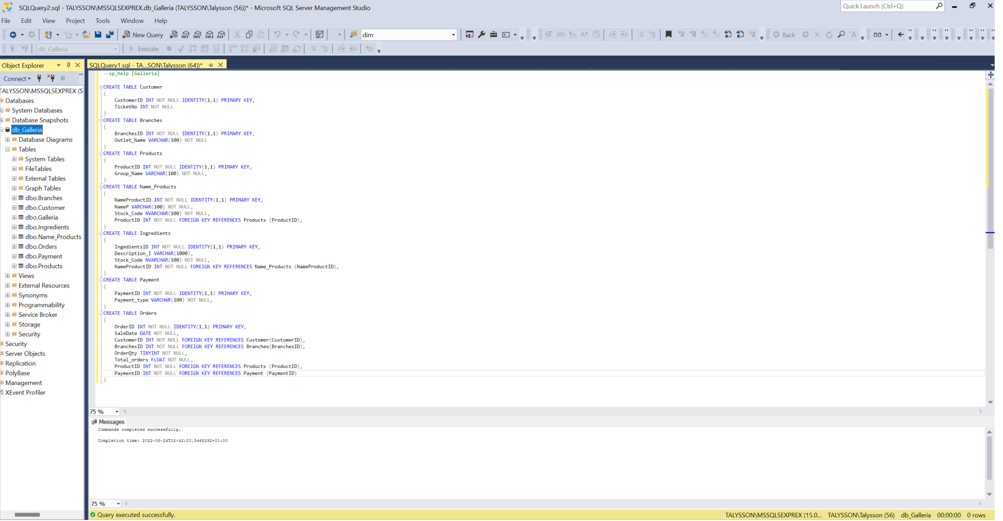
Creating dimensions and tables in SQL Server using CREATE TABLE command.

Slide 25
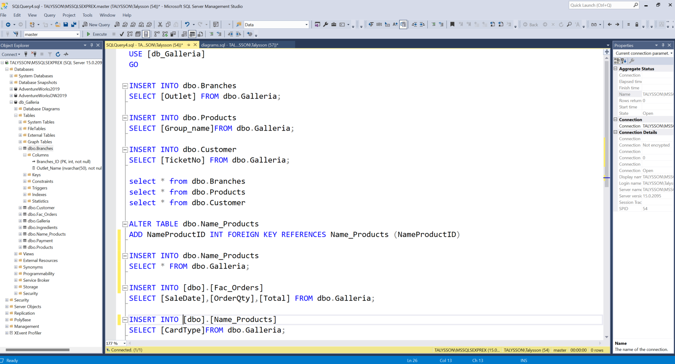
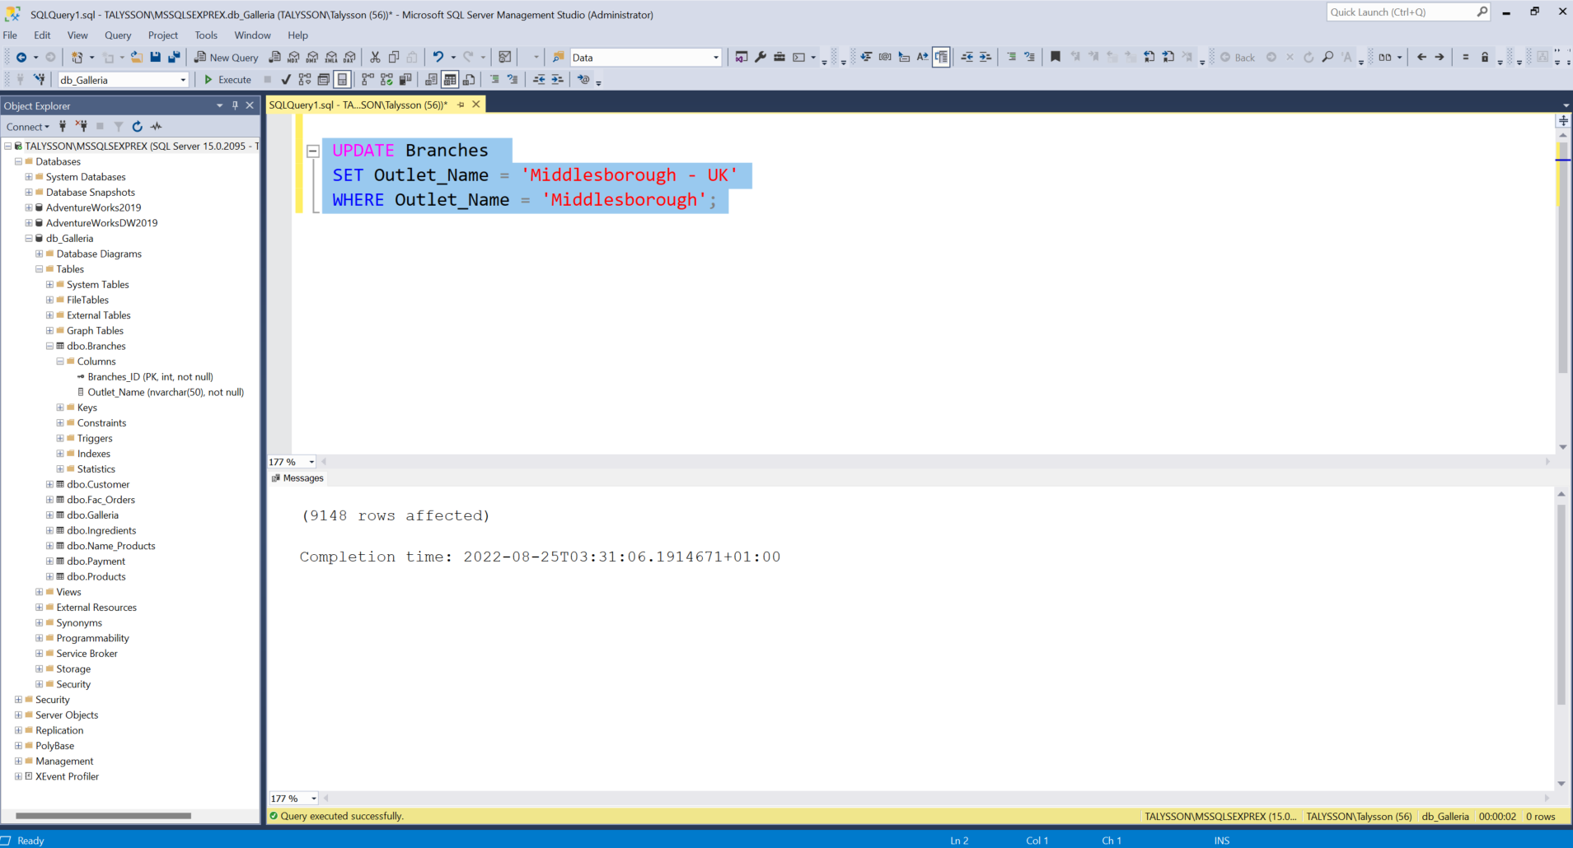
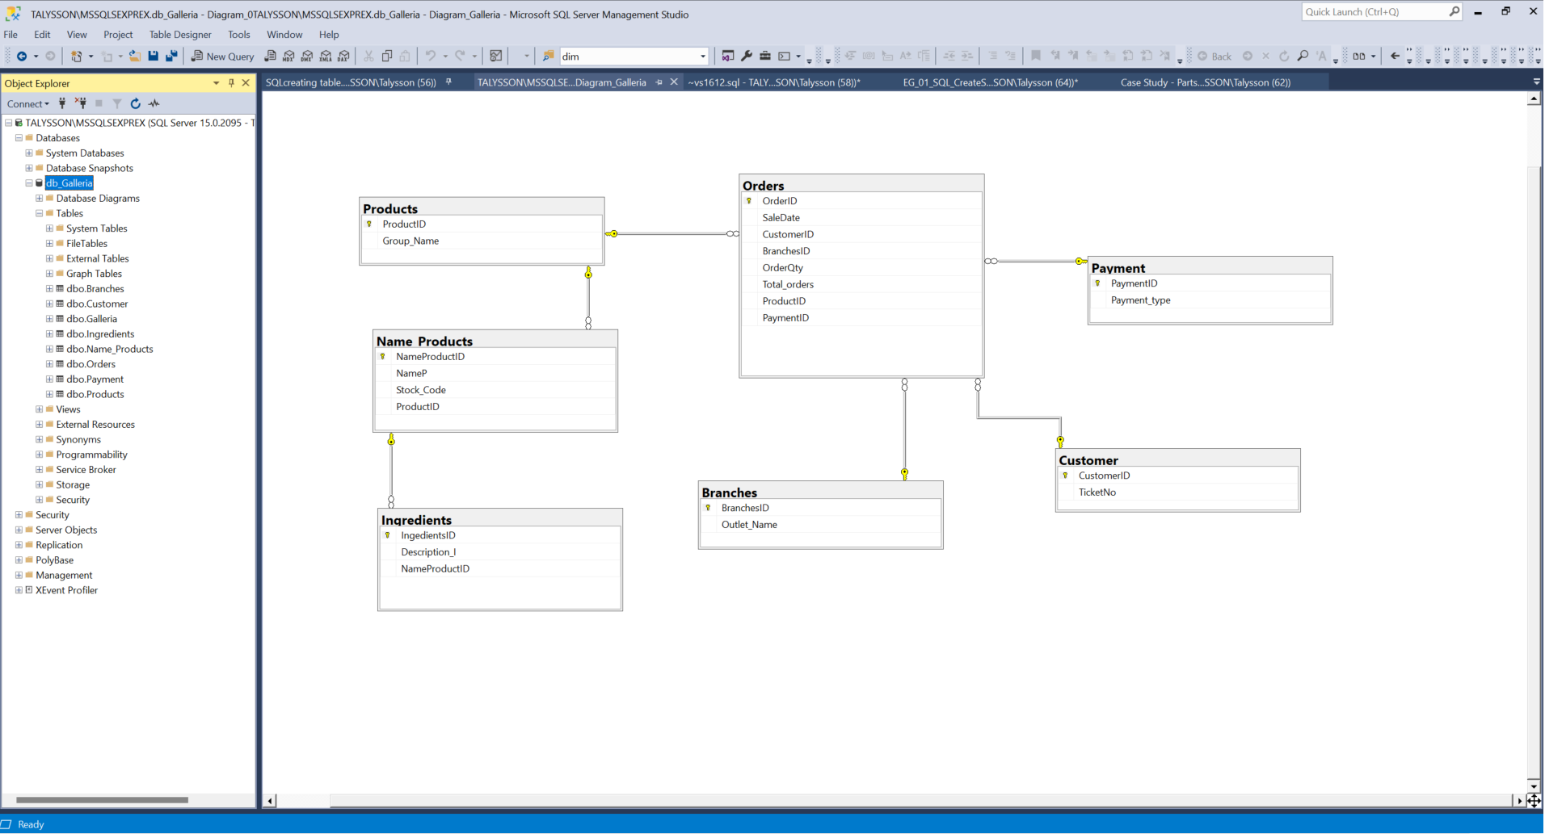
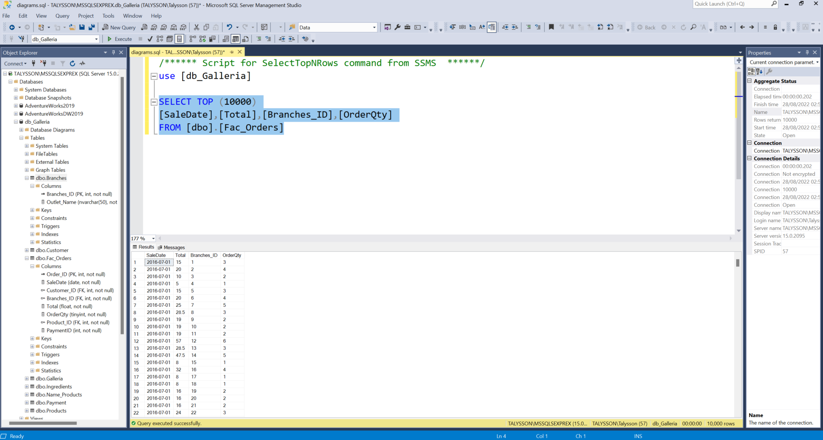
On the images bellow, we can see populating tables, diagram, cleansing of the data and manipulating features.

Slide 26

Test approaches
Creation and review of input data that should be processed by client’s application. Test data consist of correct and incorrect data. If incorrect data is entered into the system, the input should be rejected. Results of input procedures are compared with expected behaviour of application in order to determine whether input controls are in place.
Some types of data testing:
Entity Level: a data entity is an abstraction from the physical implementation of database tables;
Record level: with a direct horizon line and the pay mechanically linked to the result.
Column Level: like tables, each column has a unique name defined when it is created
. Column Value Level: the required Level property is a boolean managed property that describes if a column value is required.

Slide 27
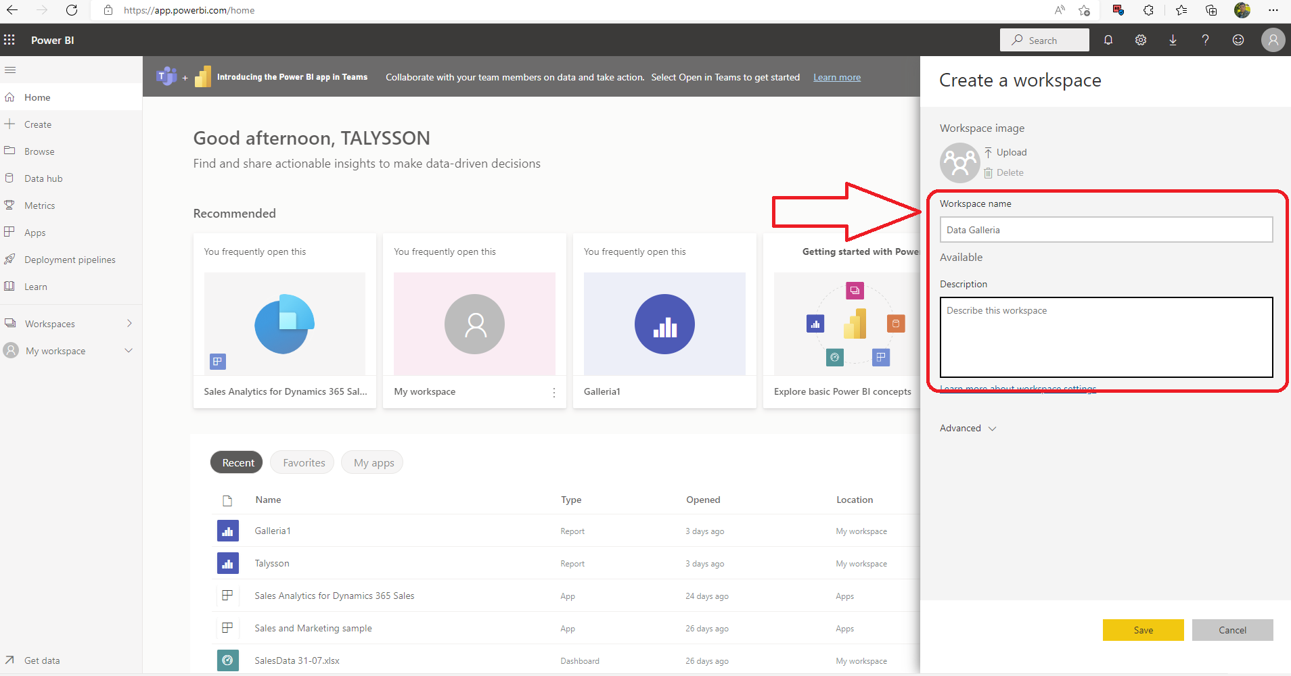
Creating a data flow diagram graphical representation of the "flow" of data through an information system, modelling its process aspects.

Slide 28
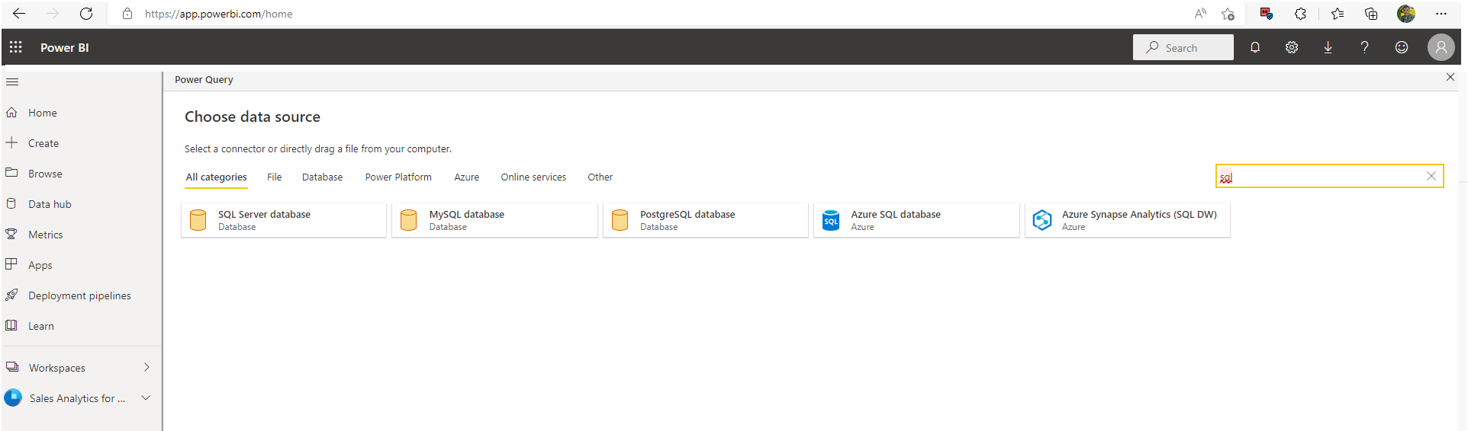
Choosing import the data on PowerBi by power query we can normalize the data and expedite the entire process.

Slide 29
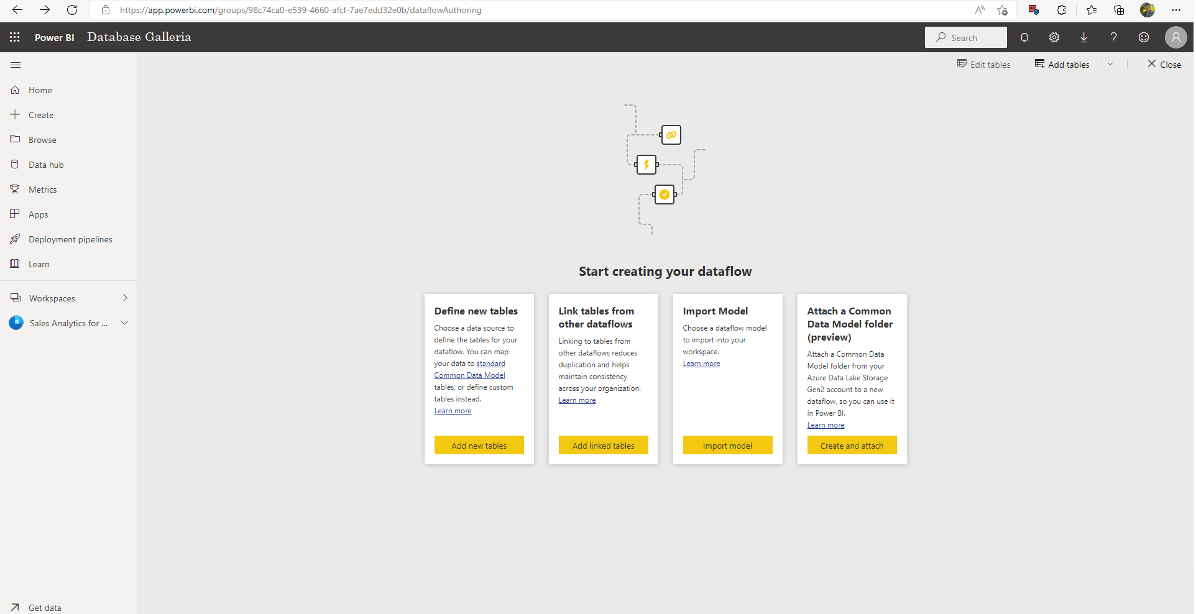
Define table by the database

Slide 30
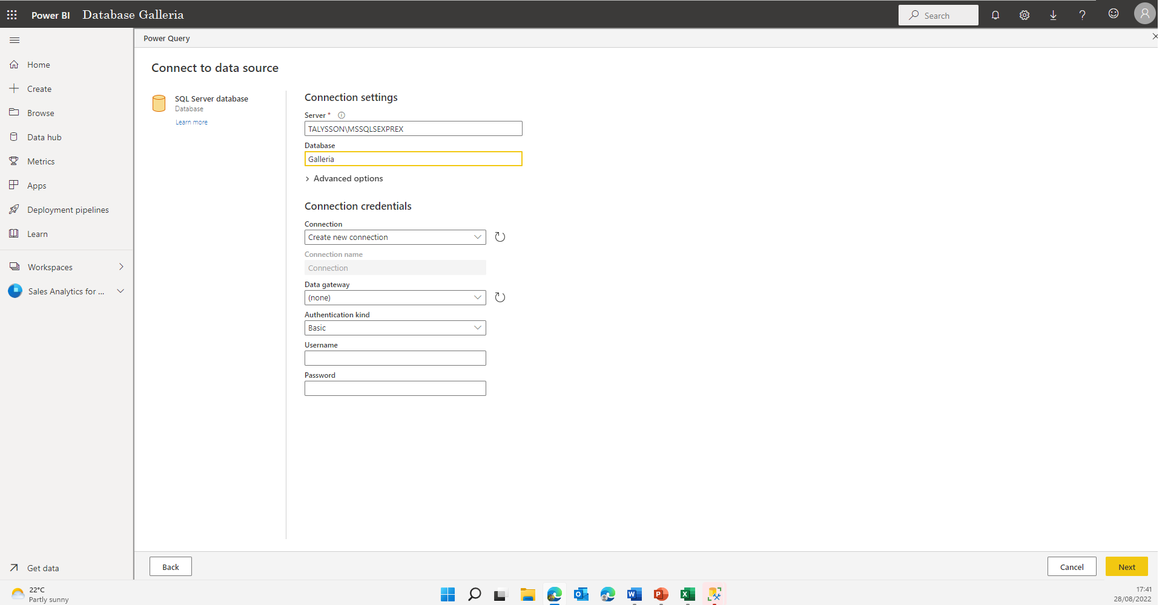
Connecting to the data source.

Slide 31
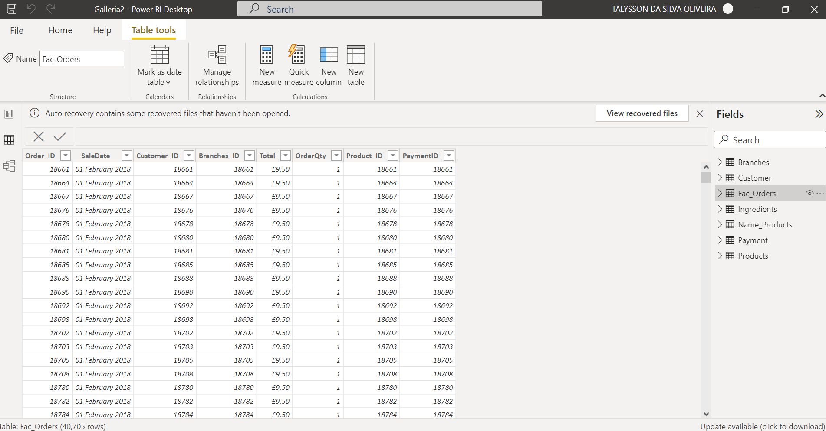
Data inside of the PowerBI, where we can transform and load the tables.

Slide 32

Measures and Visualisations: Data visualization helps us turn all your granular data into easy-to-understand, visually appealing, and useful business information. By accessing external data sources, it unify the data and apply AI-powered analytics to reveal the relationships between KPIs, the market, and the world. Data visualisation brings data to life and lets you grasp the insights hidden in the numbers. Measures are created and displayed in Report View or Data View. Measures that you create are displayed in the Fields list with a calculator icon. You can name the measures whatever you like and add them to a new or existing visualization, just like any other field. ••Below we will see the reports generated in the PowerBI.

Slide 33
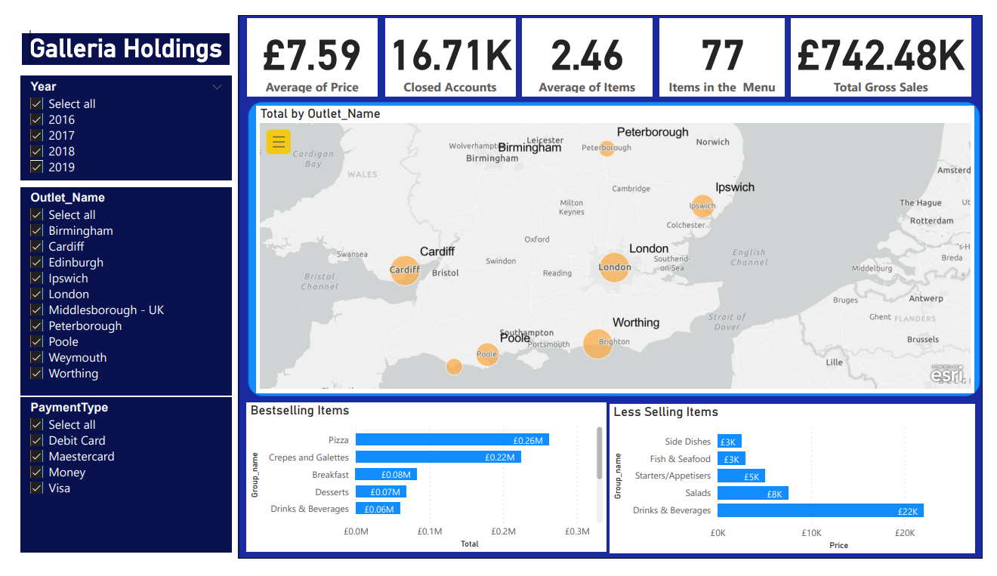

Slide 34
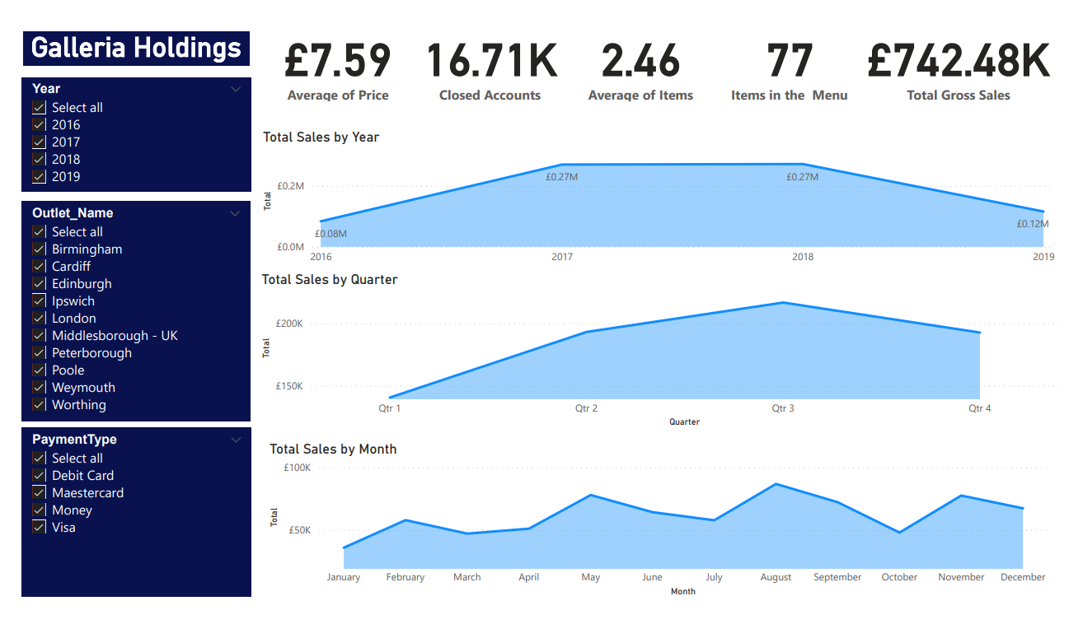

Slide 35
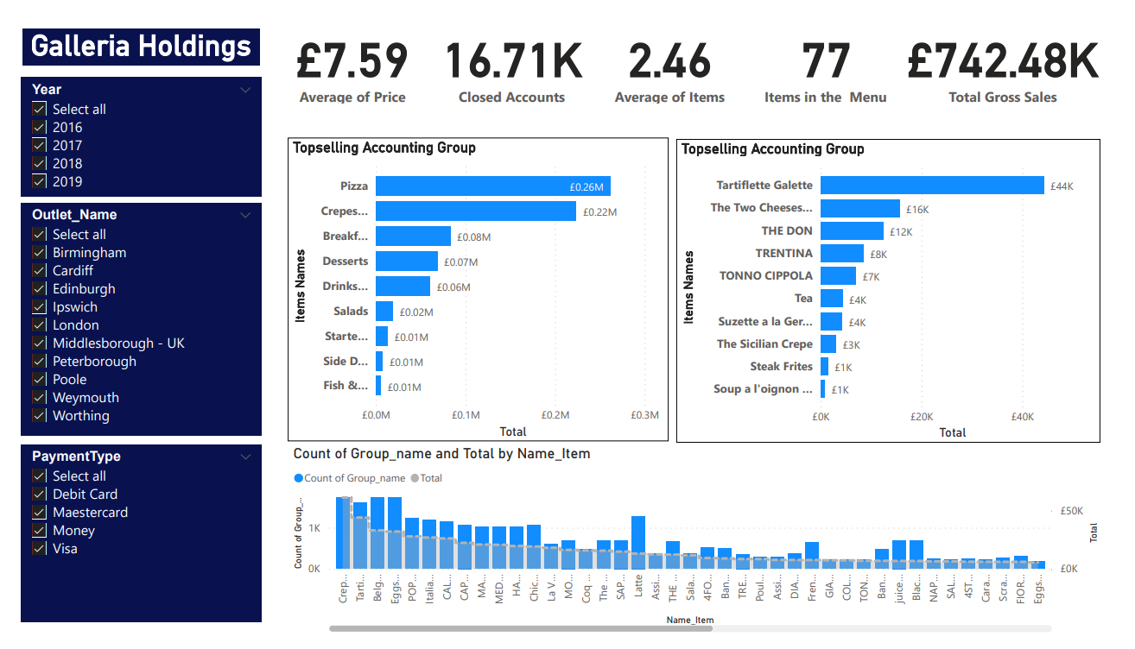

Slide 36
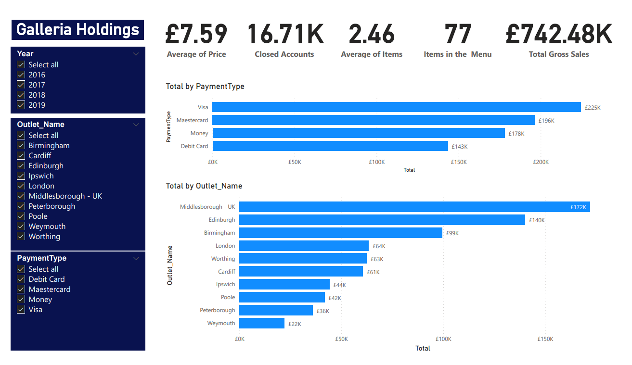

Slide 37
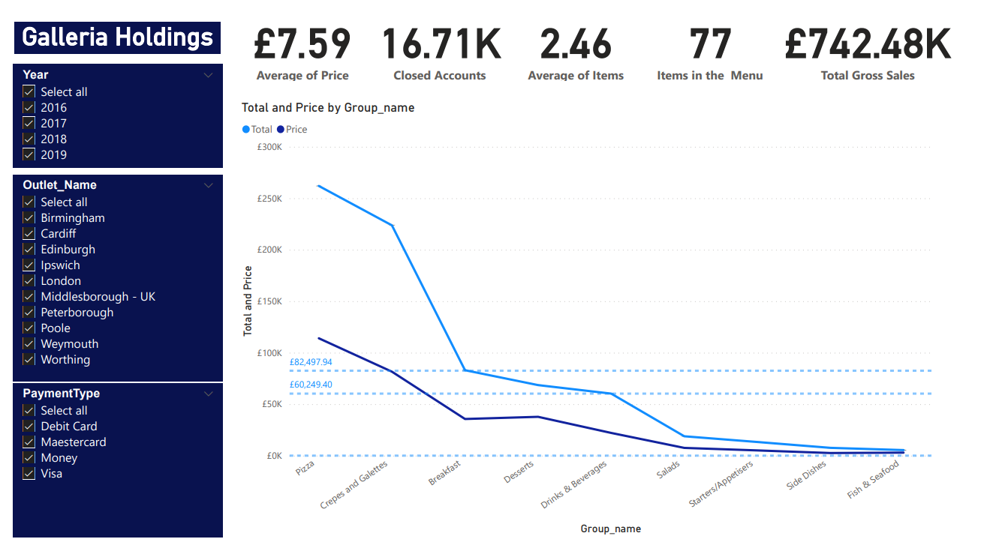

Slide 38
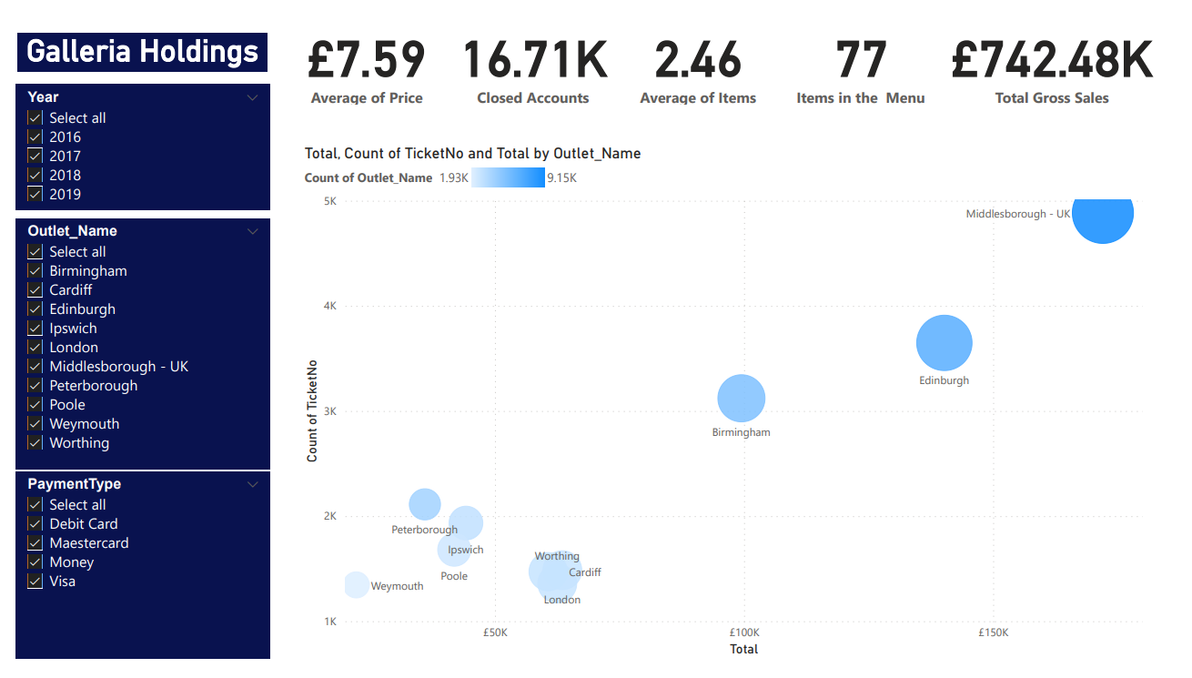

Slide 39

Conclusion
As we've covered in this presentation, various characteristics should be evaluated to be able to take for the best action of implementing a data warehouse. Armed with the necessary tools, we can get a clear picture of the size of the product we should focus on next.
With slices, filters and clear graphs, we can visualise what the report is showing us so we can take action to make the right decision. We can also visualise the growth of the company during this period and see which outlets sell the most, which products sell the most, and which products have the highest added value. Then came predictions.
Taking into consideration that some items should be kept on the menu because of customer preference, because the competition also works with these specific items or simply because they can attract more customers.
Another factor is that we can't measure profit without cost value, which makes it difficult to make a decision because we can't extract much information from it just by the number of sales and the total value.

Slide 40

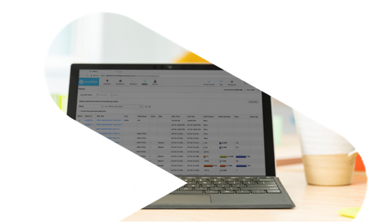
Talysson Oliveira
Data Analyst / Data Engineering

